Slide 1

Introduction to Machine Learning
Dr. Bharti
Assistant Professor
Department of Computer Science
University of Delhi
bharti@cs.du.ac.in

Slide 2
Outline
Why Machine Learning (ML)?
What is ML?
Applications
Challenges
Categories of ML algorithm
Overview of Machine Learning pipeline

Slide 3
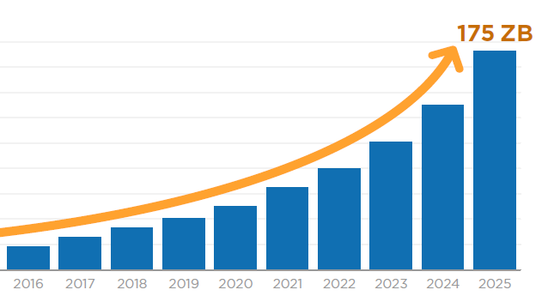
Why Machine Learning?
Figure. Growth of data [source: https://www.datanami.com/2022/01/11/big-growth-forecasted-for-big-data/]
Notes:
Volume of data collected growing day by day.
Data is growing at a 40% compound annual rate, reaching nearly 45 ZB by 2020
❑ Data production will be 44 times greater in 2020 than in 2009.  Every day, 2.5 quintillion bytes of data are created, with 90 percent of the world's data created in the past two years.  Very little data will ever be looked at by a human.  Data is cheap and abundant (data warehouses, data marts); knowledge is expensive and scarce.  Knowledge Discovery is NEEDED to make sense and use of data.  Machine Learning is a technique in which computers learn from data to obtain insight and help in knowledge discovery.

Slide 4
Why Machine Learning? (contd…)
Human expertise does not exist (navigating on Mars),
Humans are unable to explain their expertise (speech recognition)
Solution changes in time (routing on a computer network)
Solution needs to be adapted to particular cases (user biometrics)

Slide 5
Definition
“How can we build computer systems that automatically improve with experience, and what are the fundamental laws that govern all learning processes?”
How to design autonomous mobile robots that
Learn to navigate from their own experience,
How to data mine historical medical records to learn which future patients will respond best to which treatments, and
How to build search engines that automatically customize to their user’s interests.

Slide 6
What is Machine Learning?
MACHINE + LEARNING
Machine Learning is programming computers
Computers learn from data to obtain insight and
Help in knowledge discovery.
Notes:
Machine
Any digital system that take data as input, does processing and generates output.
Learning
Something that reflect in your behavior

Slide 7
What is Machine Learning? (contd…)
Tom M. Michell defines:
A machine learns
With respect to a particular task T,
Performance metric P, and
Type of experience E,
if the system reliably improves its performance P at task T, following experience E.

Slide 8

What is Machine Learning? (contd…)
Example: Spam Detection
Task T: recognizing and classifying an e-mail as good or spam.
Performance measure P: percent of e-mails correctly classified
Training experience E: a database of emails wherein each email is labeled (by spam or not spam) by users

Slide 9
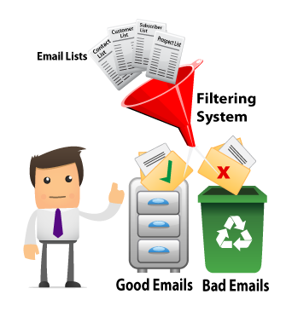

Applications
Weather Forecasting
Spam Detection
Source: Google Images

Slide 10
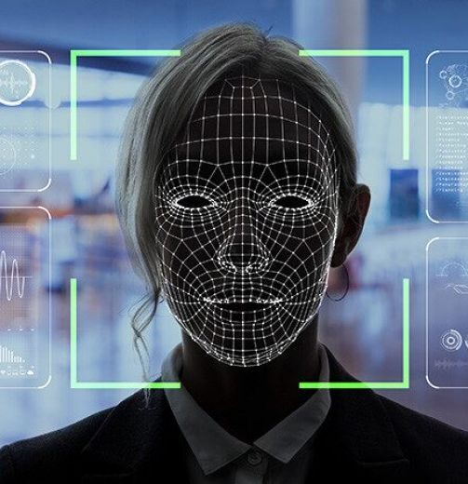
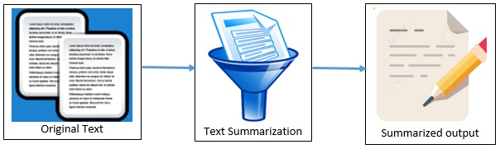
Applications (contd…)
Text Summarization
Face Recognition
Source: Google Images

Slide 11
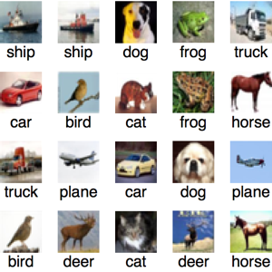
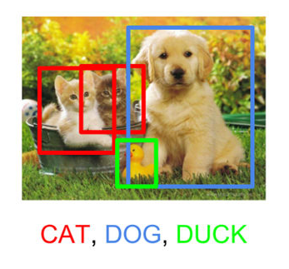
Applications (contd…)
Object Detection
Object Classification
Source: Google Images

Slide 12
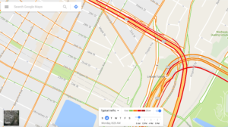
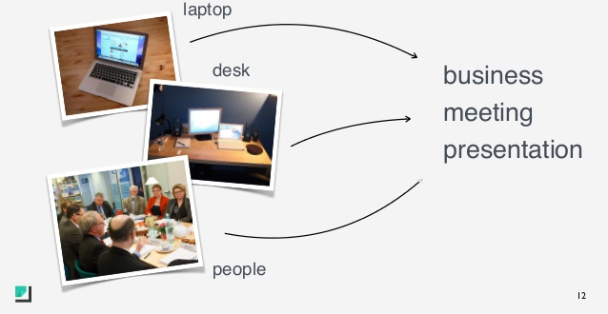
Applications (contd…)
Traffic Detection
Photo Tagging
Source: Google Images

Slide 13
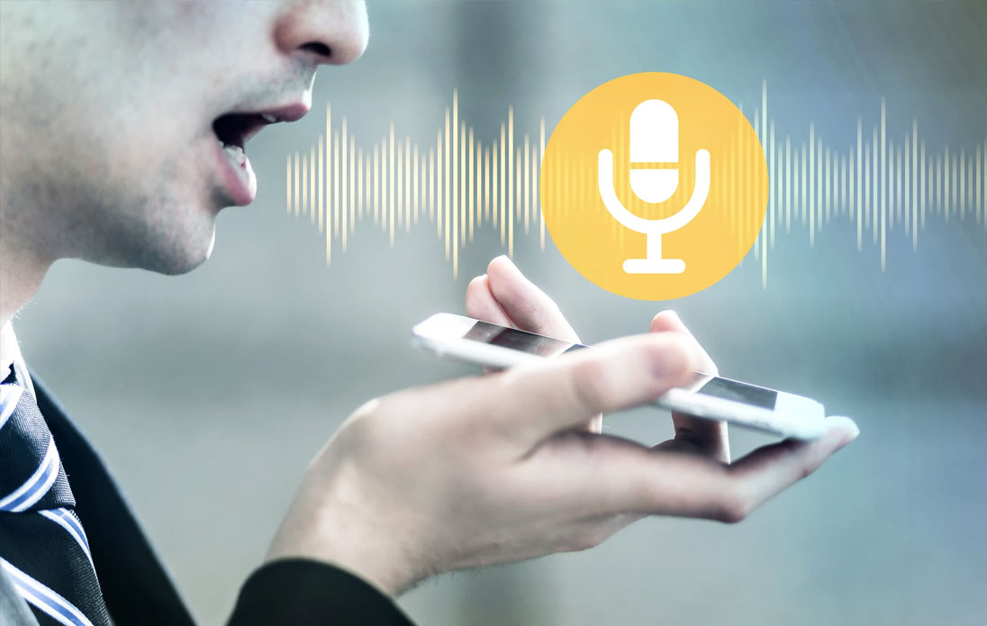

Applications (contd…)
Online Fraud Detection
Speech Recognition/ Speech-to-text
Source: Google Images

Slide 14

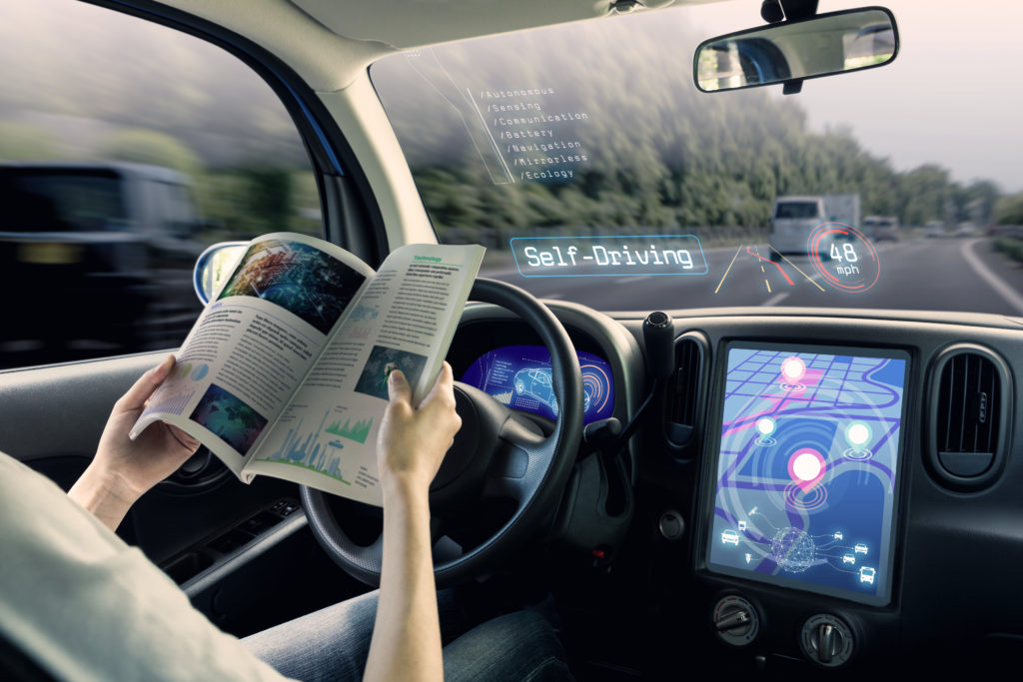
Applications (contd…)
Fingerprint Detection
Self-driving Cars
Source: Google Images

Slide 15

Applications (contd…)
Source: Google Images

Slide 16
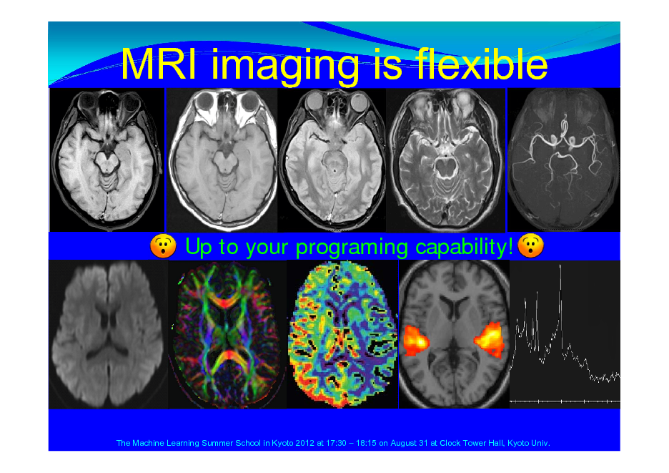
Applications in medical domain (contd…)
Identifying Diseases and Diagnosis
Drug Discovery and Manufacturing
Machine Learning-based Behavioral Modification
Medical Imaging Diagnosis
Personalized Medicine
Smart Health Records
Clinical Trial and Research
Crowdsourced Data Collection
Better Radiotherapy
Outbreak Prediction
Medical Diagnosis
Source: Google Images

Slide 17
Challenges
Complex in nature
Class imbalance
Complex and high dimensionality
Missing data
Availability of data
Data is unstructured
Presence of unlabeled data
Inconsistent or falsified data collection

Slide 18
Categories of Machine Learning Algorithms

Slide 19
Categories of Machine Learning Algorithms
Machine Learning
Supervised
Classification
Regression
Unsupervised
Clustering

Slide 20
Supervised Learning
Y (dependent Variable)
 | F₁ | F₂ | F₃ | … | F_{d} | Label / class
X₁
X₂
X₃
X_{n}
X (independent Variable)

Slide 21

Supervised Learning
Classification
Problem: Given three size of fruits and three bags. Bags are labeled as Small (S), Medium (M), and Large (L).
Pick each fruit and place it in an appropriate bag.
Source: https://www.codecademy.com/articles/regression-vs-classification

Slide 22
Supervised Learning: Classification
Y (dependent Variable)
Discrete values only
 | F₁ | F₂ | F₃ | … | F_{d} | Label / class
X₁
X₂
X₃
X_{n}
X (independent Variable)

Slide 23
Classification
Various classifiers:
Naïve bayes Classifier
Support Vector Machine
Logistic regression
Decision Tree
Random Forest
Linear Discriminant Analysis
Artificial Neural Networks
Extreme learning machine
…

Slide 24
Classification: Research Problems
Healthy vs diseased/abnormal
Multiclass classification
Cat vs Dog
Customer will buy a product or not
…

Slide 25
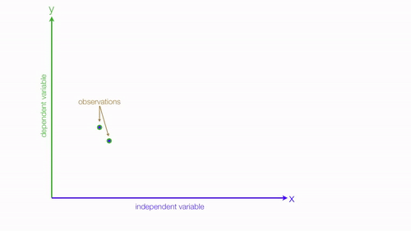
Supervised Learning
Regression
Source: https://gfycat.com/gifs/search/linear+regression

Slide 26
Supervised Learning: Regression
Y (dependent Variable)
Continuous values
 | F₁ | F₂ | F₃ | … | F_{d} | Predict
X₁
X₂
X₃
X_{n}
X (independent Variable)

Slide 27
Regression: Research Problems
To forecast stoke
To forecast disease progression
To forecast improvement in a patients health
To forecast rate of growth of a disease
…

Slide 28
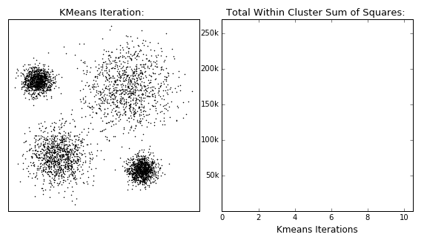
Unsupervised Learning
Clustering
Source: https://dashee87.github.io/data%20science/general/Clustering-with-Scikit-with-GIFs/

Slide 29
Unsupervised Learning
Y (dependent Variable)
Discrete values only
 | F₁ | F₂ | F₃ | … | F_{d} | Label / class
X₁
X₂
X₃
X_{n}
X (independent Variable)

Slide 30
Questions: Identify the nature of the problem
Scenario 1
Given data of size of houses on the real estate market, try to predict their price.
Scenario 2
Given a picture of a person, identify whether the person is of high school or College or Graduated.
Scenario 3
Given a picture of a person, identify the age of a person.
Scenario 4
Consider a collection of 1000 easy written on Indian Economy. Try to find out a way to group these essays into a small number that are similar or related.
Regression
Classification
Regression
Clustering

Slide 31
Pipeline to Solve a Problem using Machine Learning

Slide 32

Steps involved in Machine Learning
This Photo by Unknown Author is licensed under CC BY-SA-NC

Slide 33
Step 1: Databases
List of Datasets
Commonly used platforms:
Kaggle: https://www.kaggle.com/datasets
UCI Repository: https://archive.ics.uci.edu/ml/index.php

Slide 34
Step 2: Cleaning and preparing data
Unknown values
Should we drop samples?
Should we drop feature(s)?
Can’t say, it depends upon data
Solution:
Imputation
Retaining the majority of the dataset's data and information by substituting missing data with a different value
Mean or median
Mode

Slide 35
Step 2: Cleaning and preparing data
Solution:
Imputation techniques
Next or Previous Value [time-series data or ordered data]
K Nearest Neighbors
Maximum or Minimum Value [if range is available]
Missing Value Prediction [apply Linear regression]
Most Frequent Value [for nominal and numerical features]
Average or Linear Interpolation
(Rounded) Mean or Moving Average or Median Value
Fixed Value
…

Slide 36
Step 2: Feature Extraction and Selection
Feature Extraction
Statistical Methods
1st order
2nd order or higher order
Structural Methods
Model-based Methods
Fourier Transformation
Gabor filters
Wavelet transform
Feature Selection
Filter Approach
Univariate
Multivariate
Wrapper Approach
Embedded Feature selection

Slide 37
Various segmentation approaches
Region growing
Region splitting and merging

Slide 38
Step 3: Dataset partition: Train, Validate and Test
Hold-out approach
K-fold cross-validation
LOOCV

Slide 39
Step 3: Training
Apply algorithm according to the problem
Regression
Classification
Clustering
…

Slide 40
Step 4: Testing & Performance Metric
Depends on the problem:
Confusion matrix
ROC and AUC
R-score
Mean Square Error
….

Slide 41
Step 5: Improve
Do hyperparameter tuning or change the learning algorithm,

Slide 42
Take Away Message
Understand the problem
Understand the nature of data
Then decide analysis pipeline
Identify the objective

Slide 43
Reference
Tom M. Mitchell, “Machine Learning”, McGraw-Hill, Inc. New York, NY, USA ©1997, ISBN:0070428077
https://www.holehouse.org/mlclass/

Slide 44
Thank You

